Slide 1
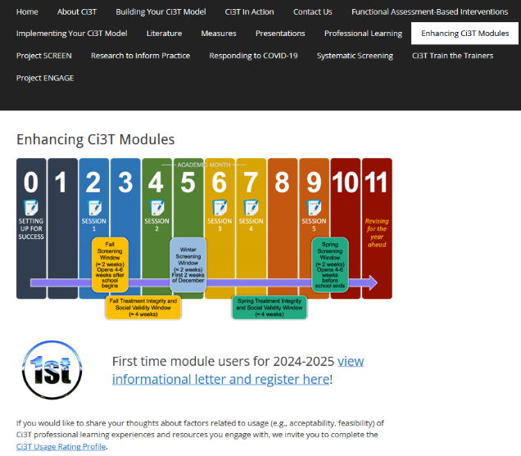
Implementing Comprehensive, Integrated, Three-tiered (Ci3T) Models: Using Data to Inform Instruction
Enhanced Ci3T Implementation Series and Delivery (E-Ci3T) Session 2
If you have not done so already, we invite you to visit ci3t.org/enhance to access modules and complete a one-time registration process!

Slide 2














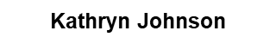







Ci3T Research Team
Grant Allen
Matthew Aschliman
Tammy Becker
Allison Bernard
Carrie Brandon
Amy Briesch
Mark Buckman
Amy Buffington
Donna Cauley
Sandy Chafouleas
Eric Common
Howard Diacon
Kathleen Lynne Lane
Jessica Matus
Wendy P. Oakes
David Royer
Elise Sarasin
Rebecca Sherod
Joni Weiss
Stacie Williams

Slide 3

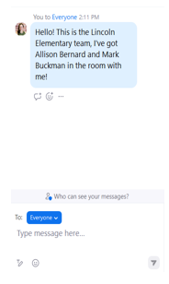
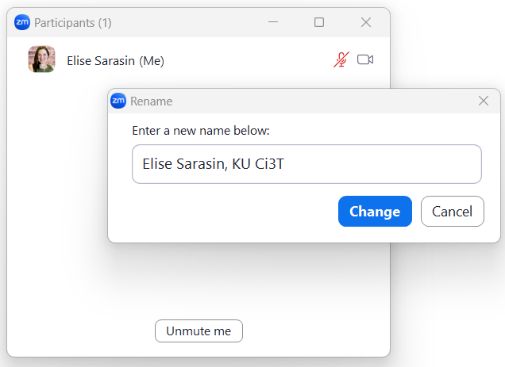

Zoom Logistics
If you are facilitating a Ci3T Leadership Team Symposium session at a satellite location, please email us a list of the names, email addresses, and schools of those attending.
To help us put you in breakout rooms with your colleagues today we are renaming you with your school initials and first and last name
If there are multiple people in the room with you, please list their first and last names and email in the chat!

Slide 4
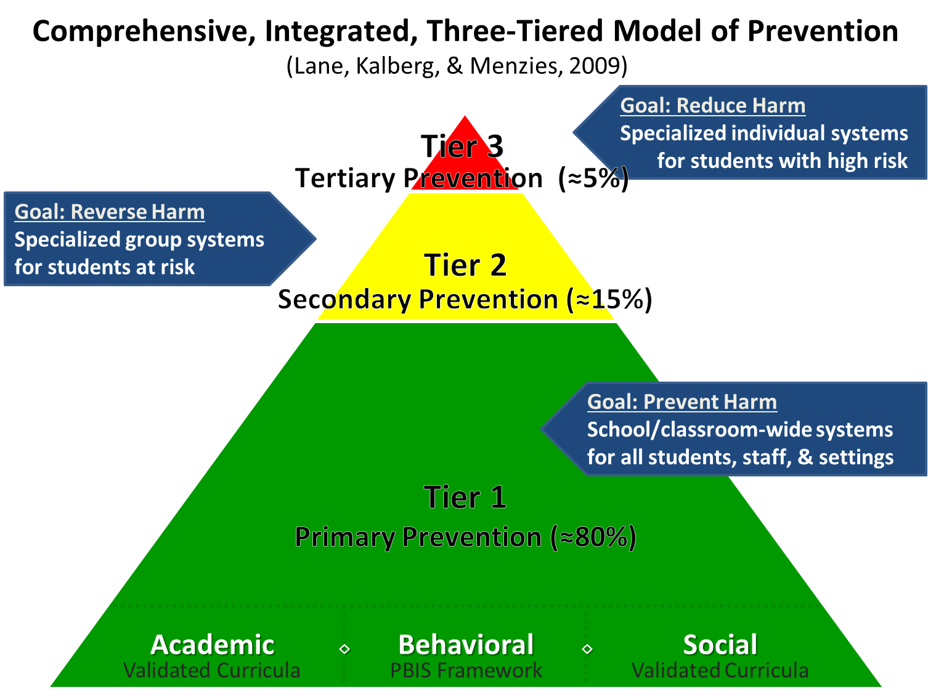
Comprehensive, Integrated, Three-Tiered Model of Prevention 1

Slide 5
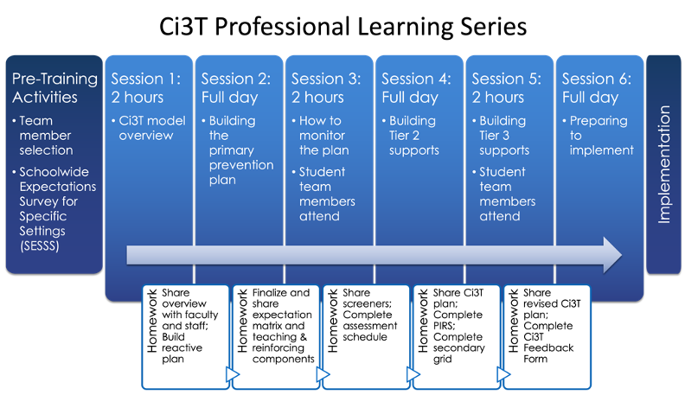
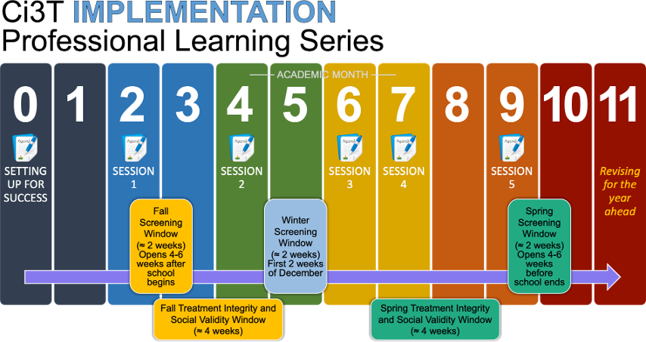




Ci3T Comprehensive
Professional Learning Plan

Slide 6
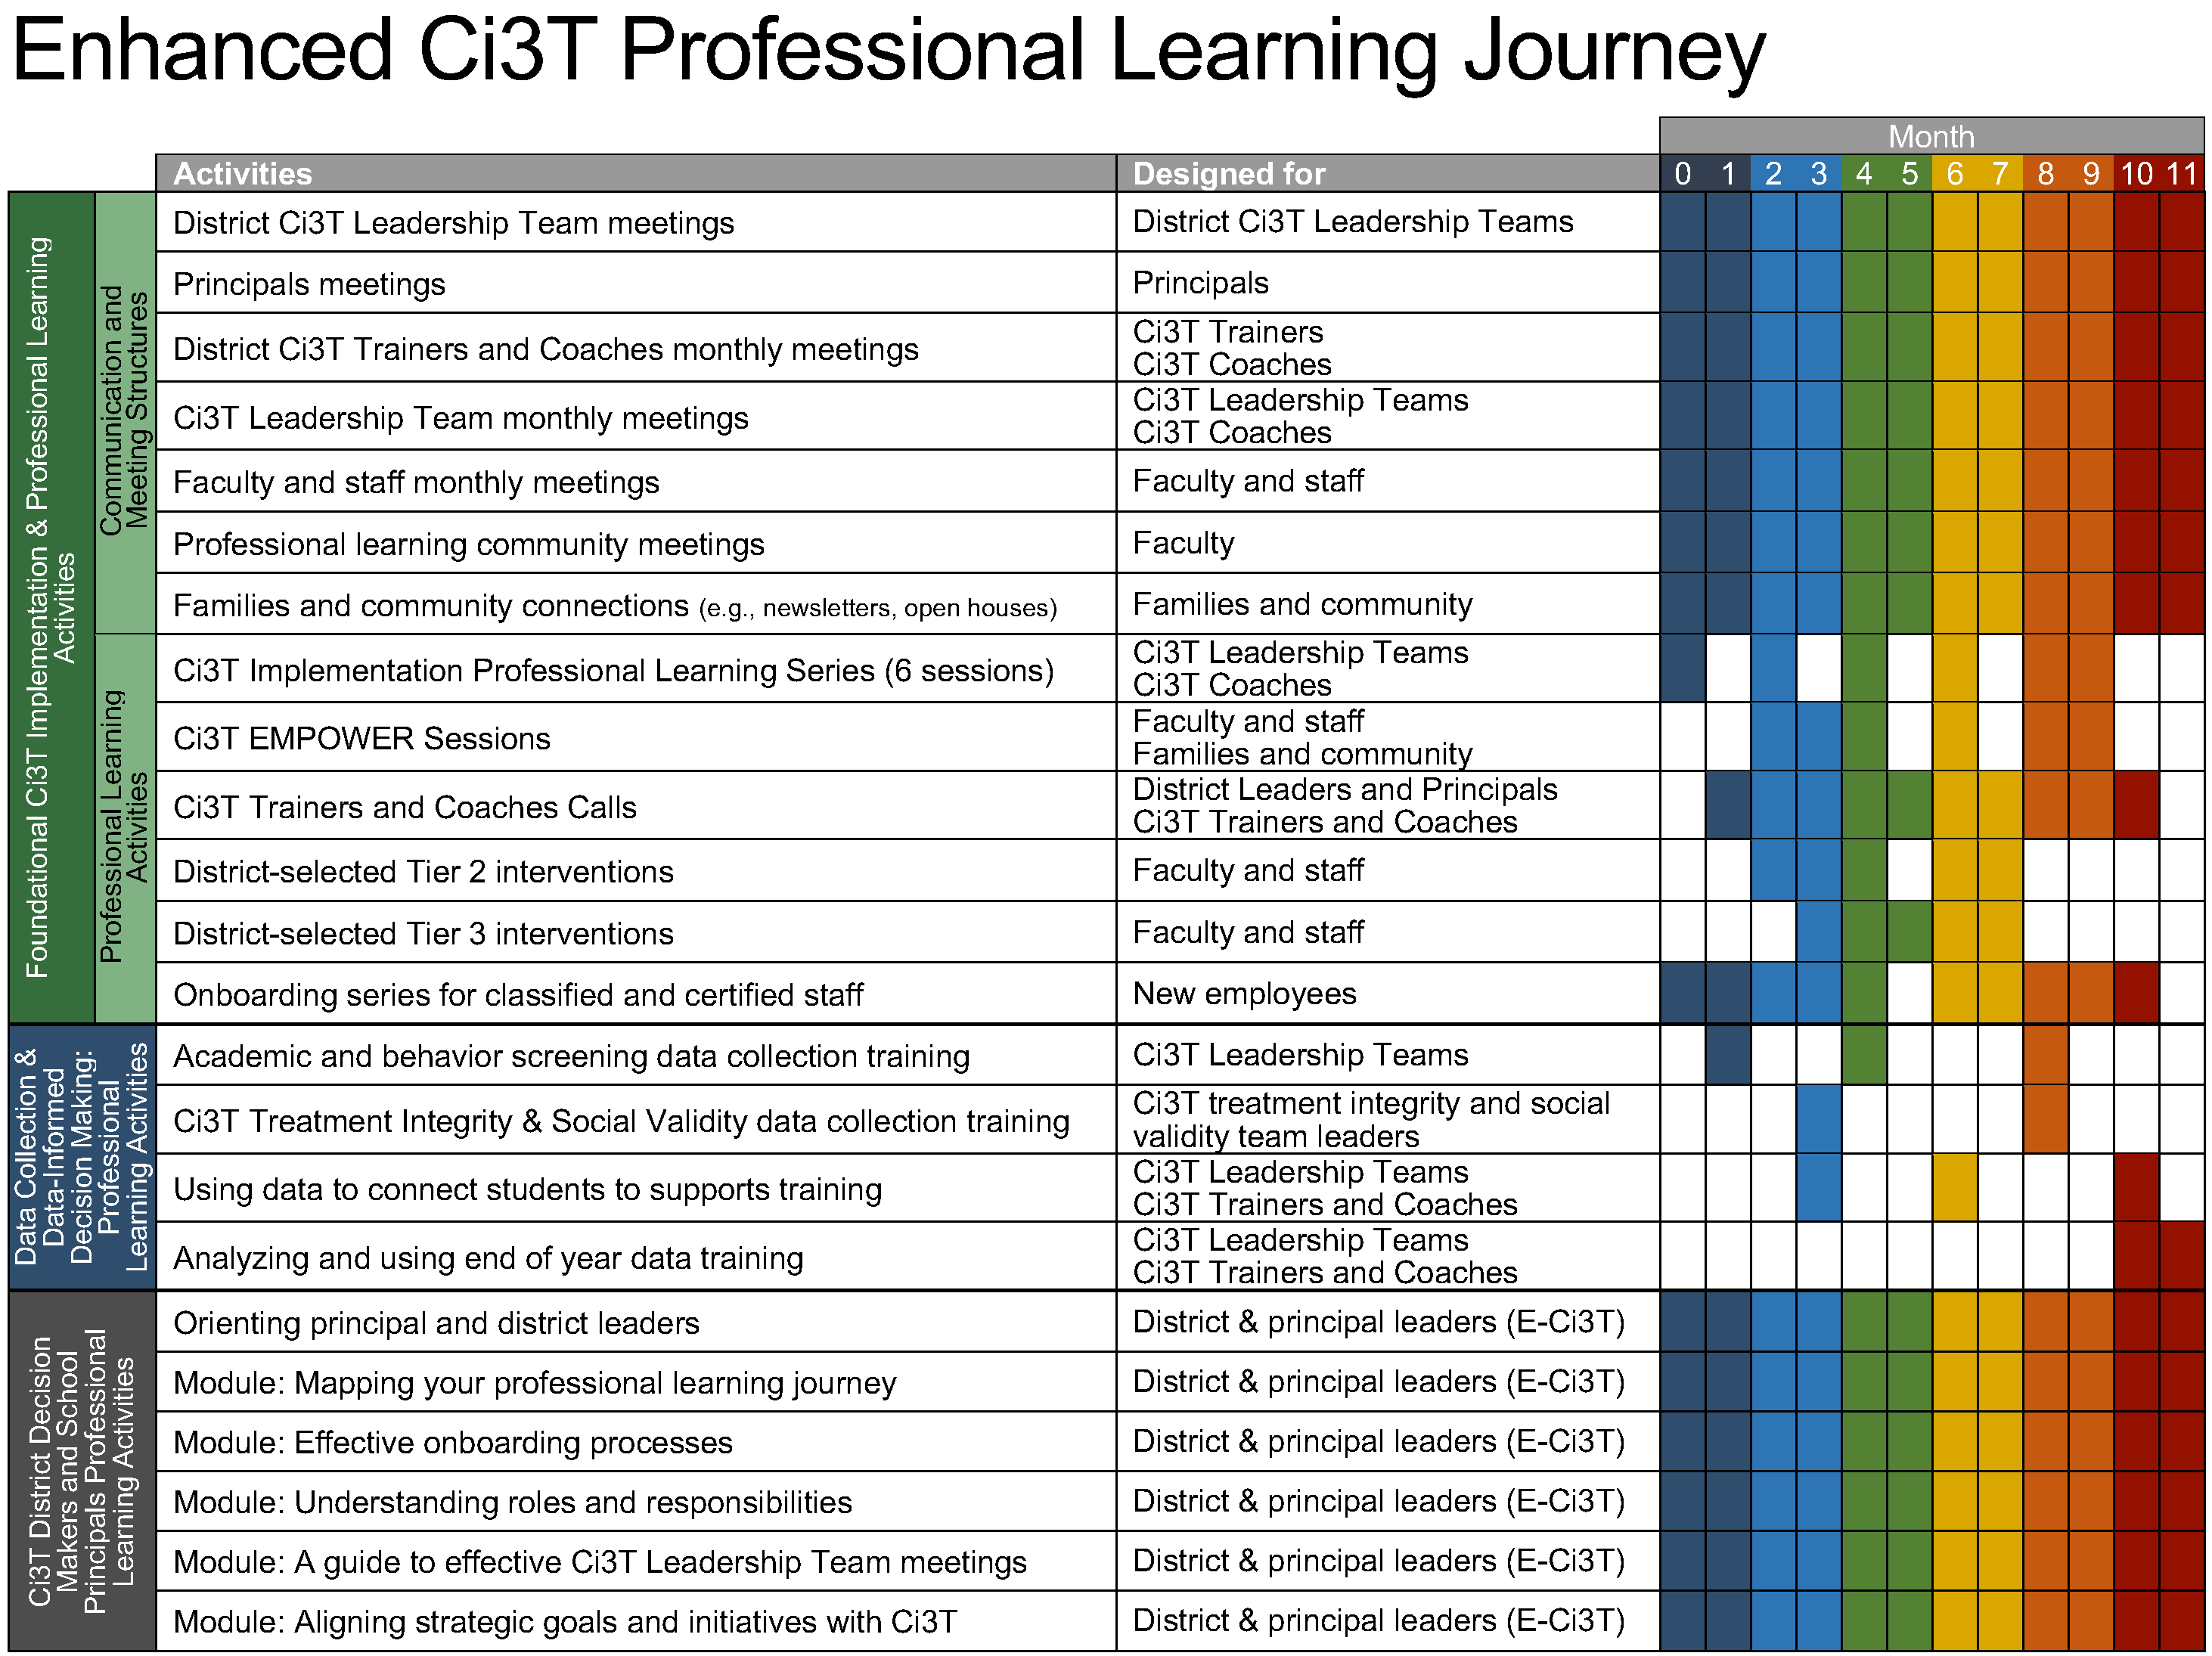
Enhanced Ci3T Implementation Series and Delivery

Slide 7
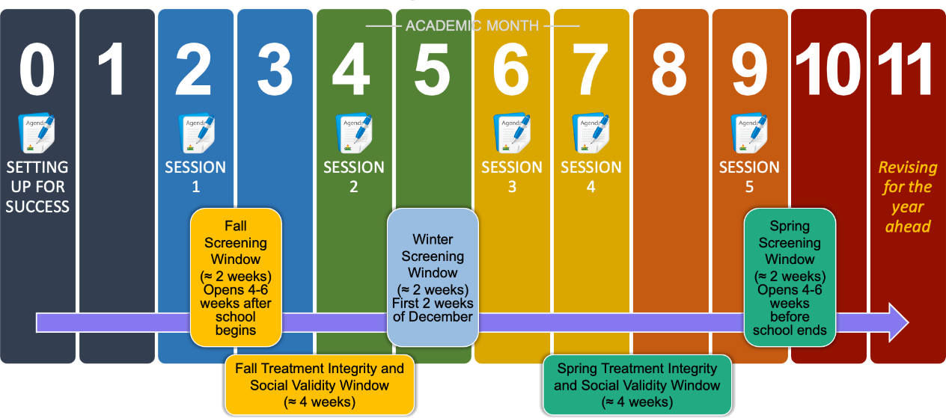
Ci3T Implementation Professional Learning Series
Notes:
The Ci3T Implementation Professional Learning Series is a 6-part series that spans the academic year. Sessions are timed to correspond to important milestones including: the beginning of the school year (e.g., kicking off the year, rolling out the Ci3T plan), screening windows, and treatment integrity and social validity windows.
Each session is data-informed, meaning attending Ci3T Leadership Team members review data, which are used to (a) identify successes, (b) identify focus areas (e.g., aspects of implementation that require additional attention, often via professional learning), and (c) create action plans to share data back and address focus areas.
Sessions applicable for both new and seasoned implementers as the focus is on predicable components of Ci3T implementation, space to review and respond to data, exploring resources to support implementation efforts, and beginning conversations and action plans.

Slide 8
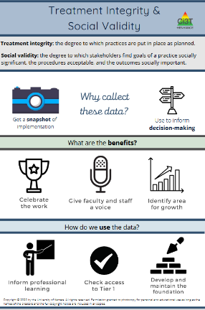
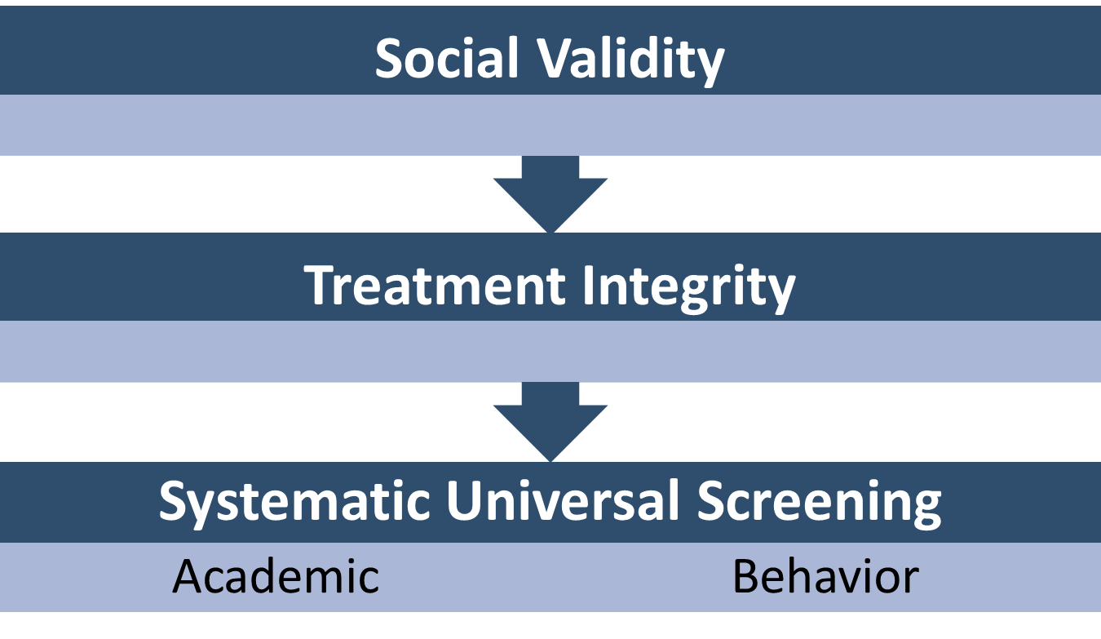
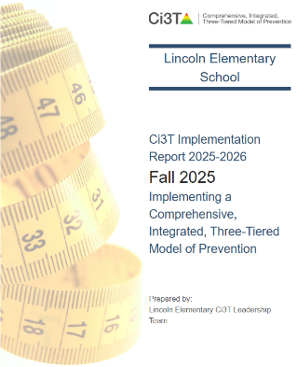
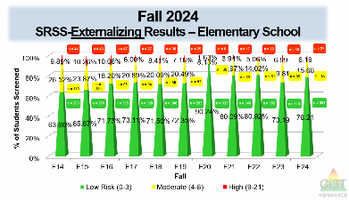
Essential Components of Primary (Tier 1) Prevention Efforts

Slide 9



Enhancing Ci3T Modules
ci3t.org/enhance

Slide 10
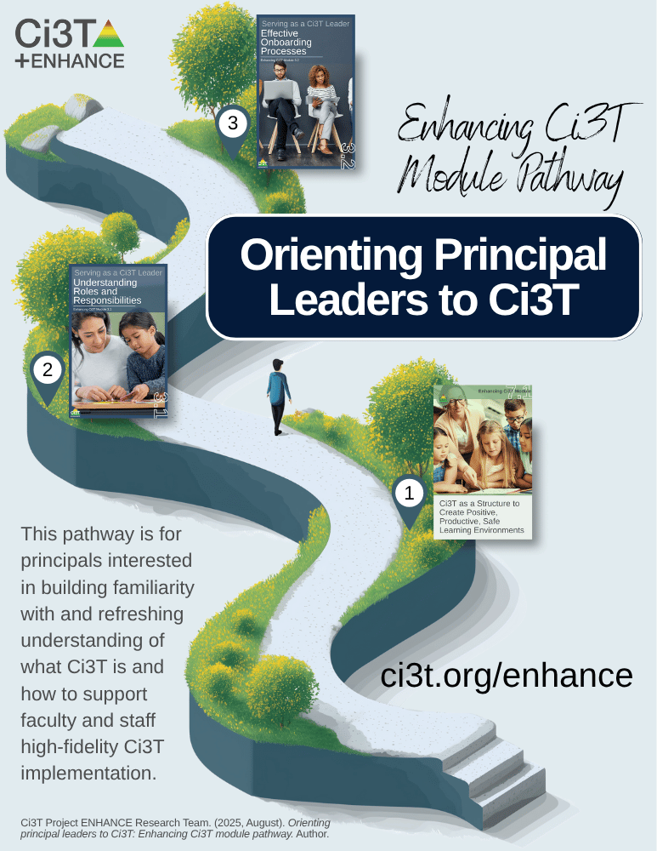
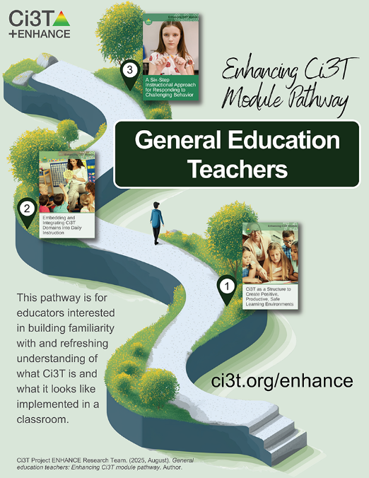
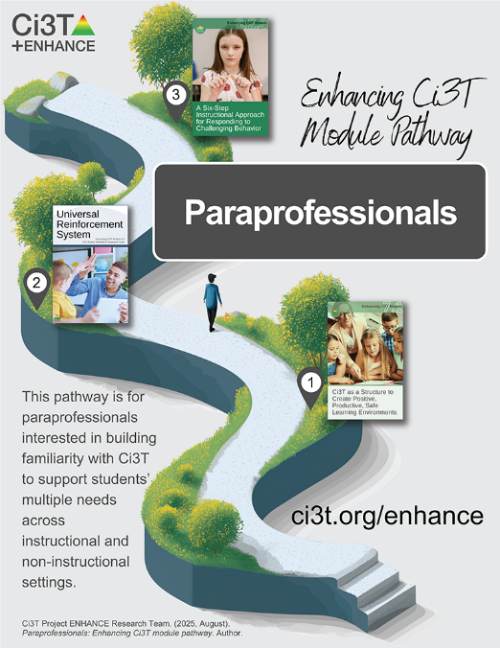
Module Pathways

Slide 11
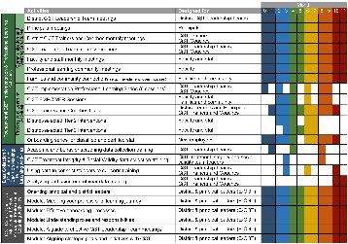

Session Outcomes
Finalize plans to collect and use social validity and treatment integrity data.
Interpret fall screening data at the school- and classroom-level to inform professional learning and use of effective practices to support students (e.g., low-intensity strategies, Tier 2 and 3 interventions).
Reflect on use of strategies for communicating to and supporting all stakeholders and make adjustments as necessary to support the creation of collaborative, positive, productive, and safe learning environments.
If you are a Board Certified Behavior Analyst (BCBA), you may accrue up to 2 learning continuing education units (CEUs) for attending this session. See agenda for task list alignment. Throughout the session we will share 4 key words, write those down to turn in after the session!

Slide 12
Agenda
Welcome
Preparing to Collect and Use Social Validity & Treatment Integrity Data
Systematic Screening in a Ci3T Model of Prevention
Using Fall Screening Data to Inform Instruction
  Primary (Tier 1) Prevention Efforts
  Teacher-Delivered, Low-Intensity Strategies
  Secondary (Tier 2) and Tertiary (Tier 3) Supports
Facilitating Clear Communication and Collaborations with Stakeholders
Wrapping Up and Moving Forward

Slide 13
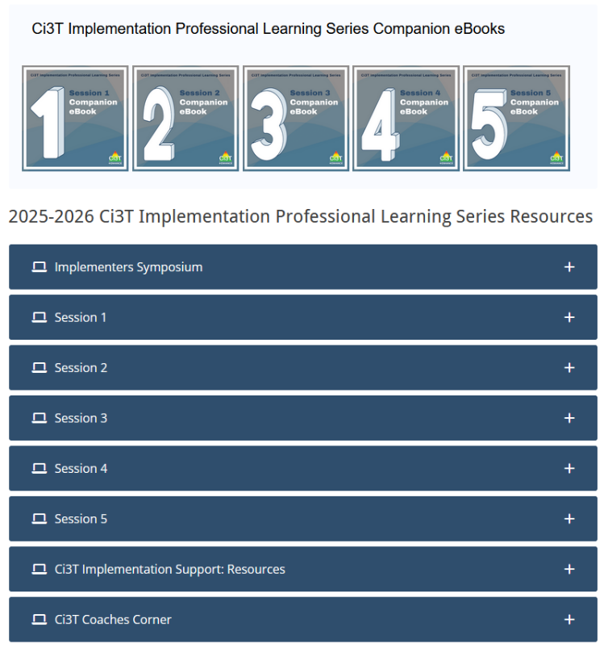
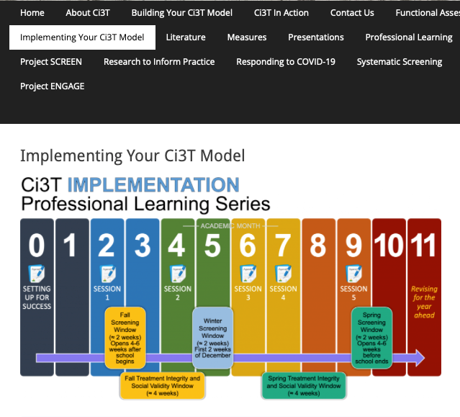
Accessing Professional Learning Materials
ci3t.org/imp

Slide 14
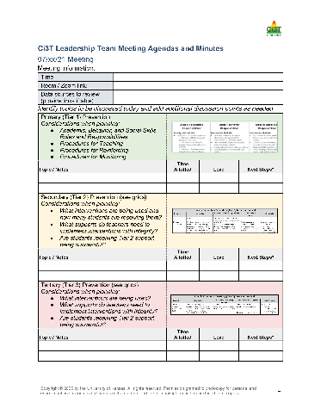

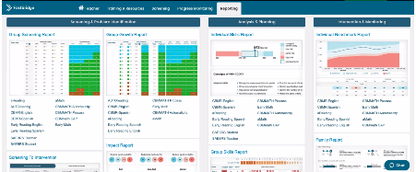

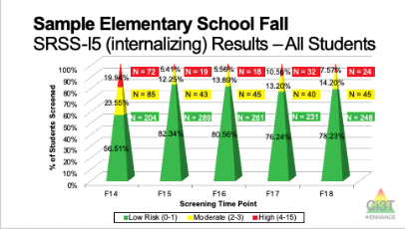
Materials for Today’s Session
Ci3T Leadership Team Agenda
Ci3T Implementation Manual
Fall Screening Data
ci3t.org

Slide 15

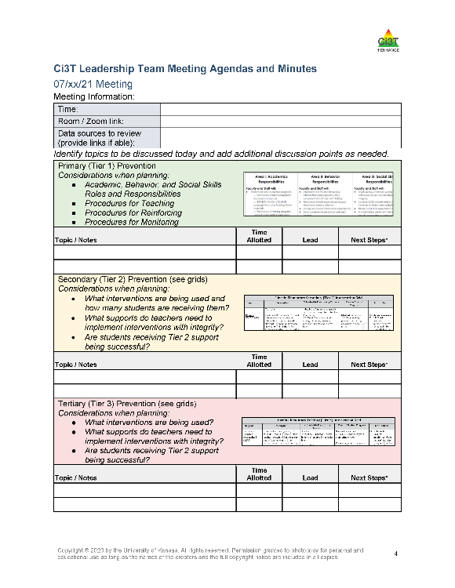
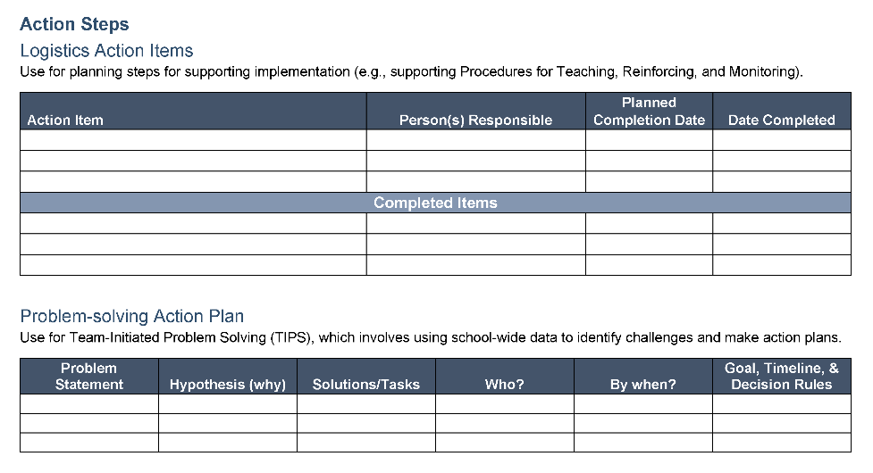

Ci3T Leadership Team Agenda Template
1.2 TEAM OPERATING PROCEDURES
Tier 1 leadership team has (a) regular meeting format/agenda that prompts the regular review of Tier 1 practices, systems, and data, (b) minutes available to all staff for review, (c) established and regularly used team norms, (d) defined meeting roles (e.g., timekeeper, facilitator, recorder), (e) regular (e.g., quarterly) two-way data sharing and communication with advanced tiers teams to inform decision making, (f) a current action plan, (g) procedure for evaluating fidelity of team operating procedures (e.g., Team Initiated Problem Solving [TIPS] Fidelity Checklist) at least twice annually, and (h) a formal process to monitor the impact of team norms and procedures on ensuring all team members are able to participate as equal partners

Slide 16
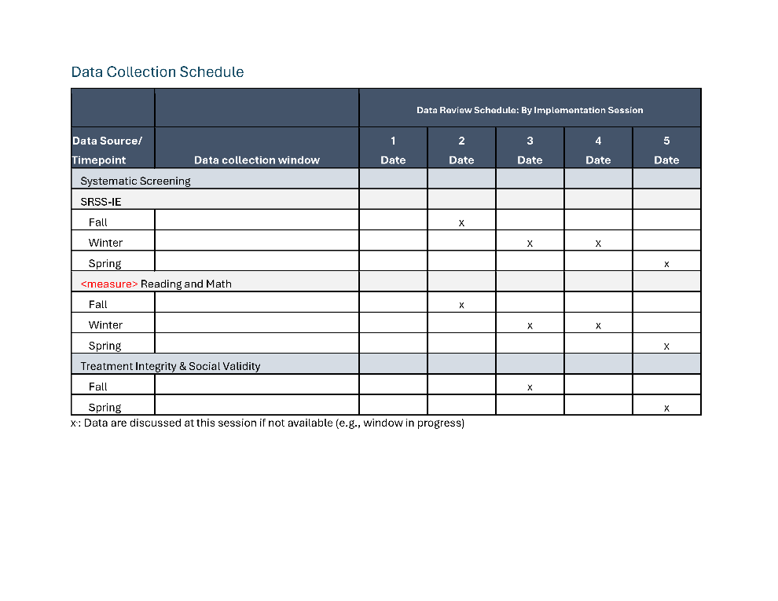
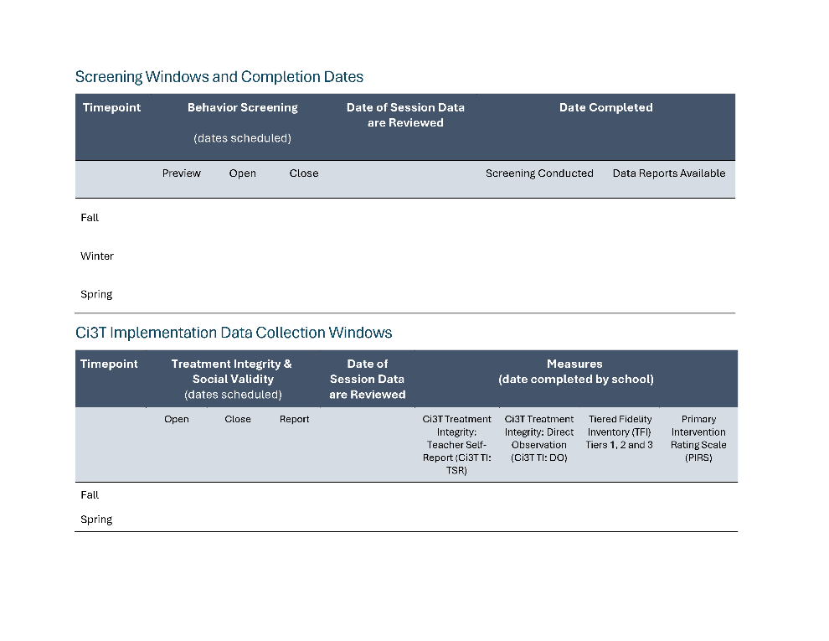
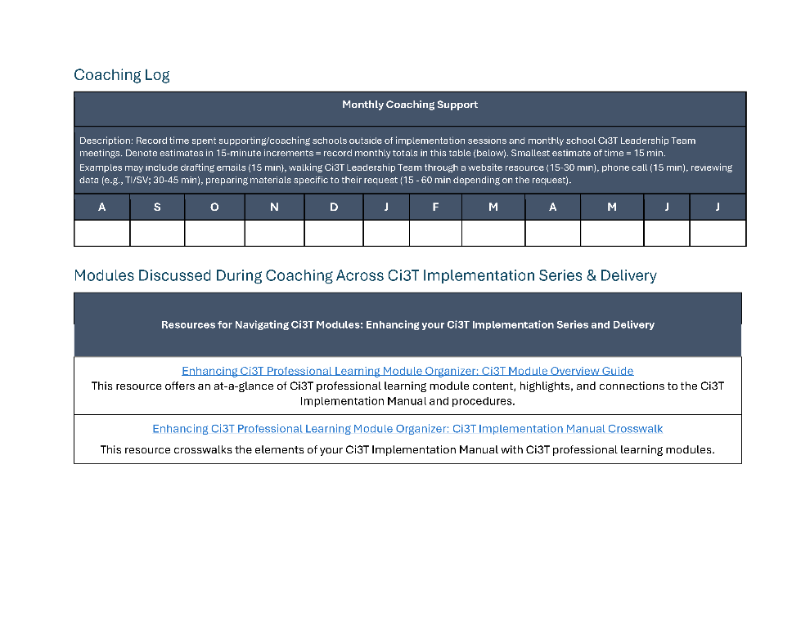
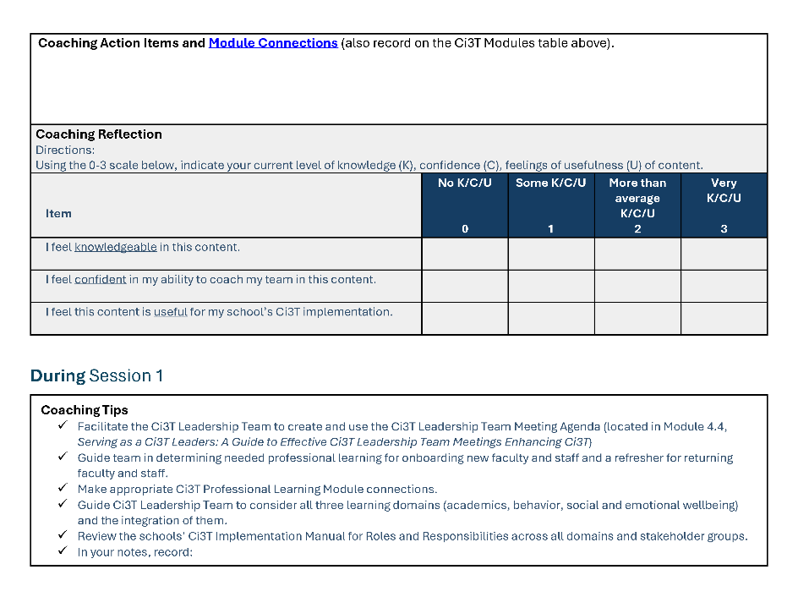
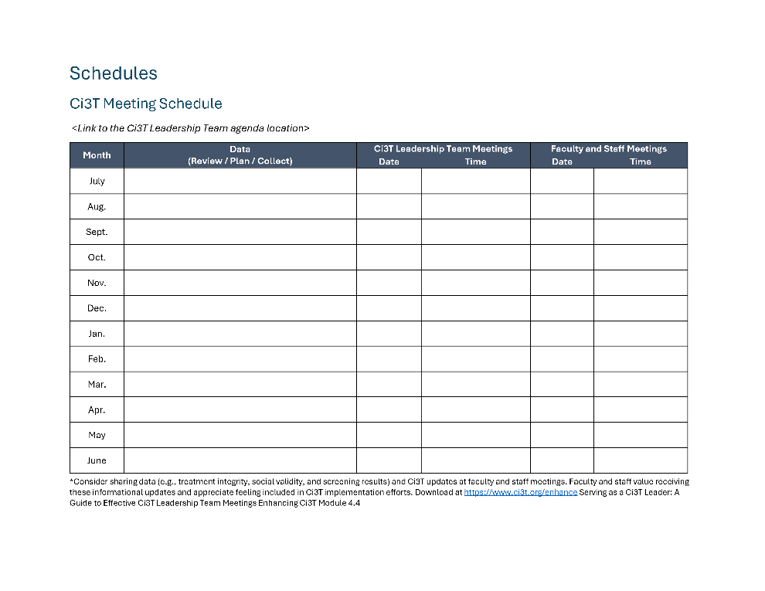
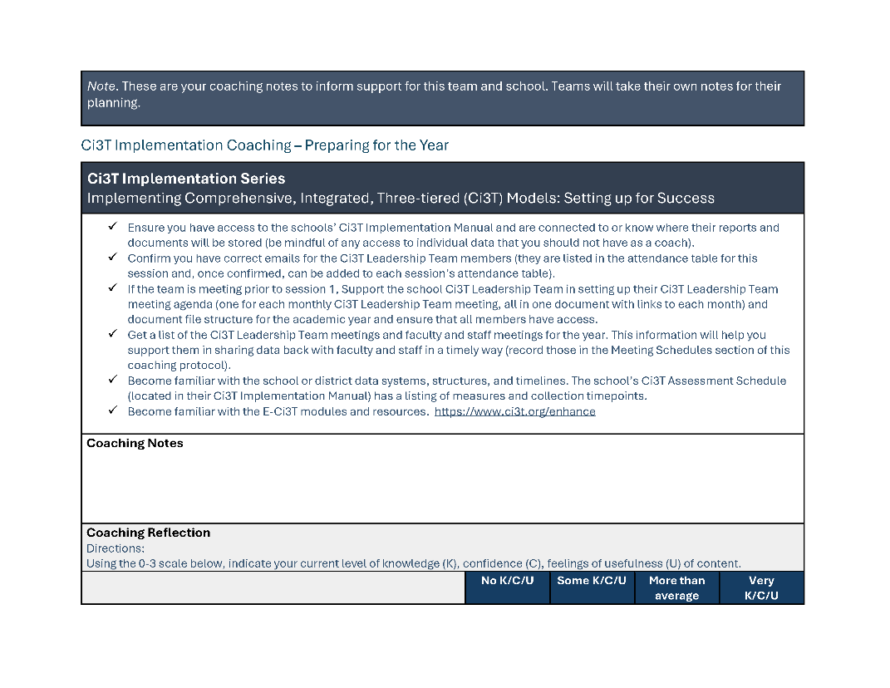
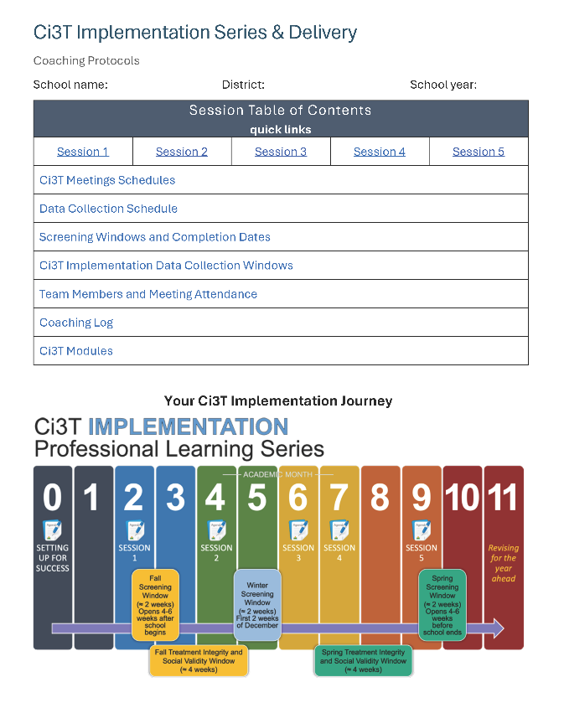
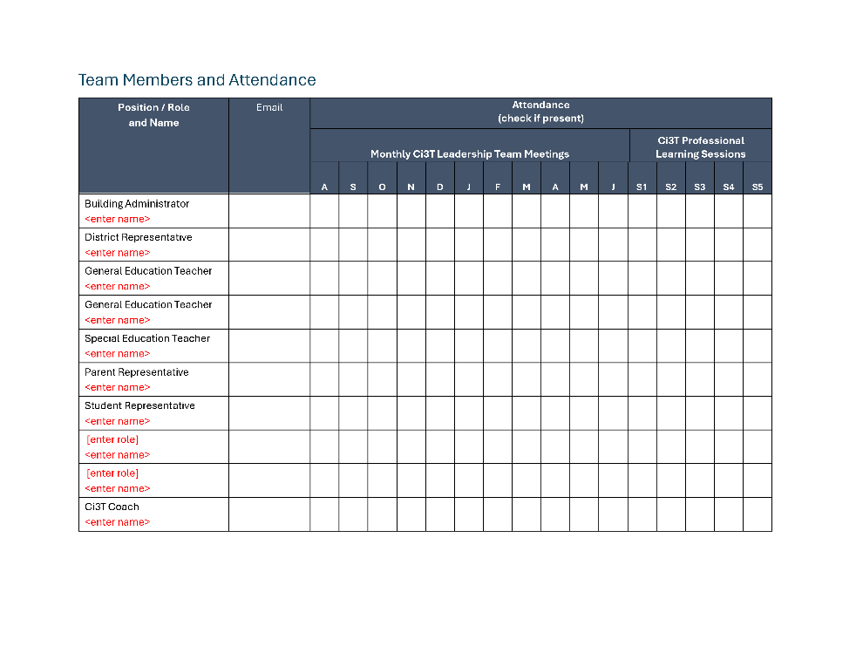
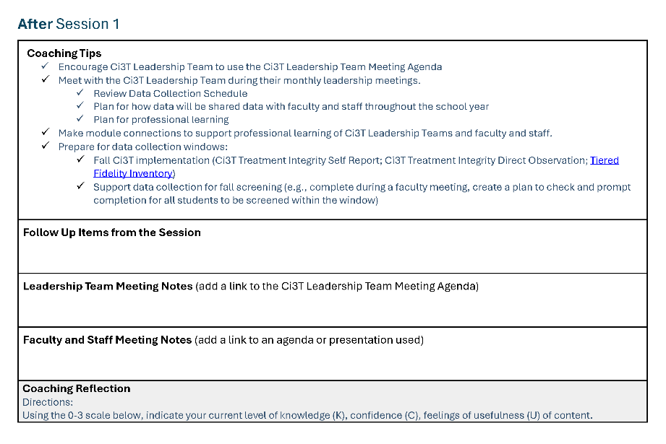
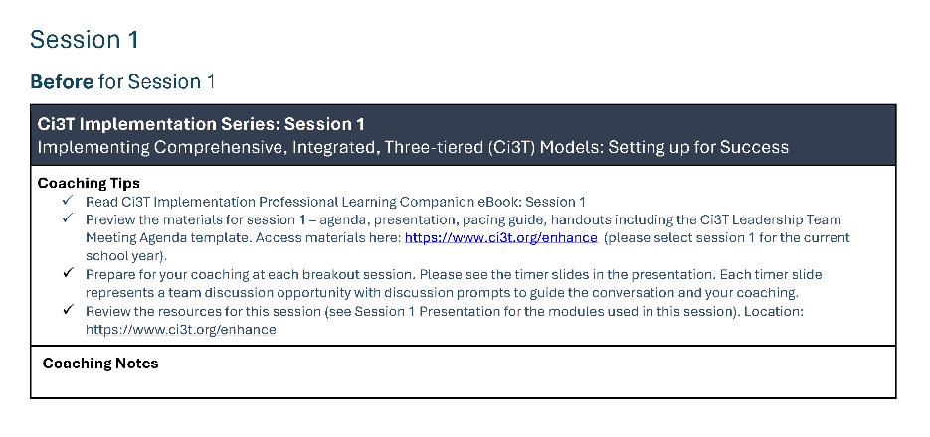
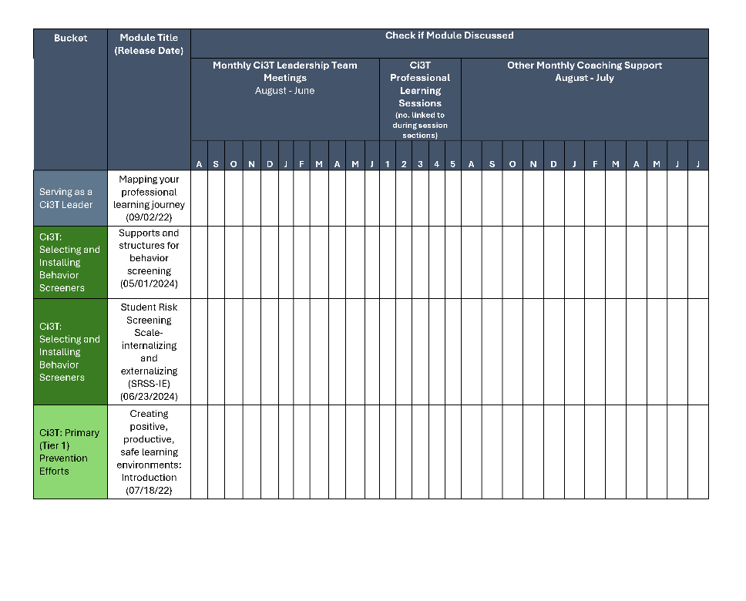
Coaching Protocol

Slide 17
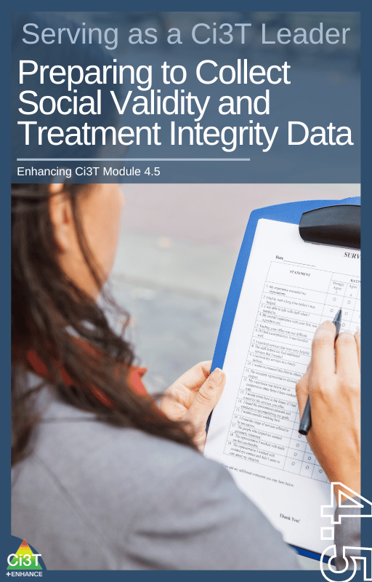
Preparing to Collect and Use Social Validity and Treatment Integrity Data

Slide 18
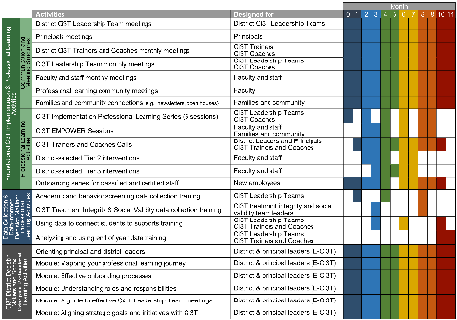
Session Outcomes
Finalize plans to collect and use social validity and treatment integrity data.
Interpret fall screening data at the school- and classroom-level to inform professional learning and use of effective practices to support students (e.g., low-intensity strategies, Tier 2 and 3 interventions).
3. Reflect on use of strategies for communicating to and supporting all stakeholders and make adjustments as necessary to support the creation of collaborative, positive, productive, and safe learning environments

Slide 19
Essential Components of Primary (Tier 1) Prevention Efforts

Slide 20
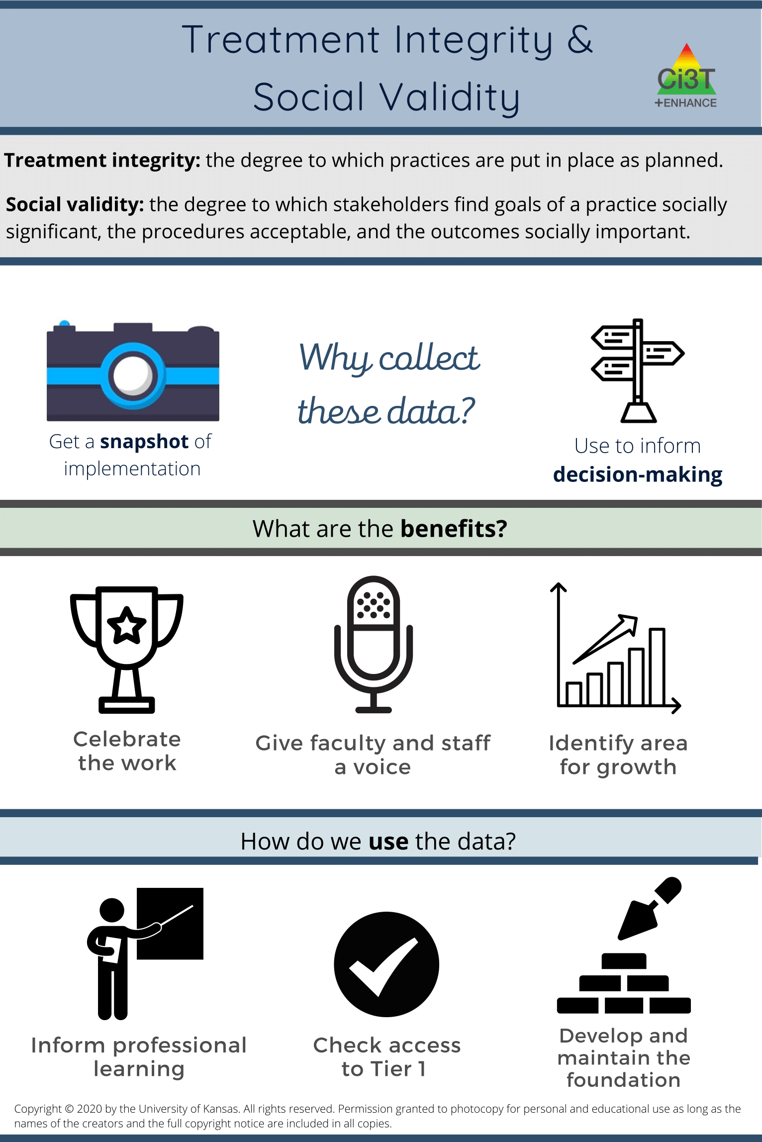
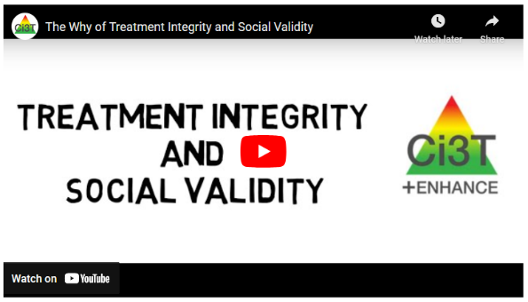
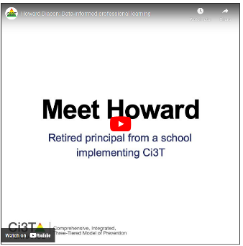
Preparing to Collect SV & TI Data
Prioritize opportunities to share the “why” of treatment integrity and social validity with staff
  Email or newsletter
  Faculty and staff meeting
Consider allocating faculty or staff meeting to complete Treatment Integrity and Social Validity Measures

Slide 21
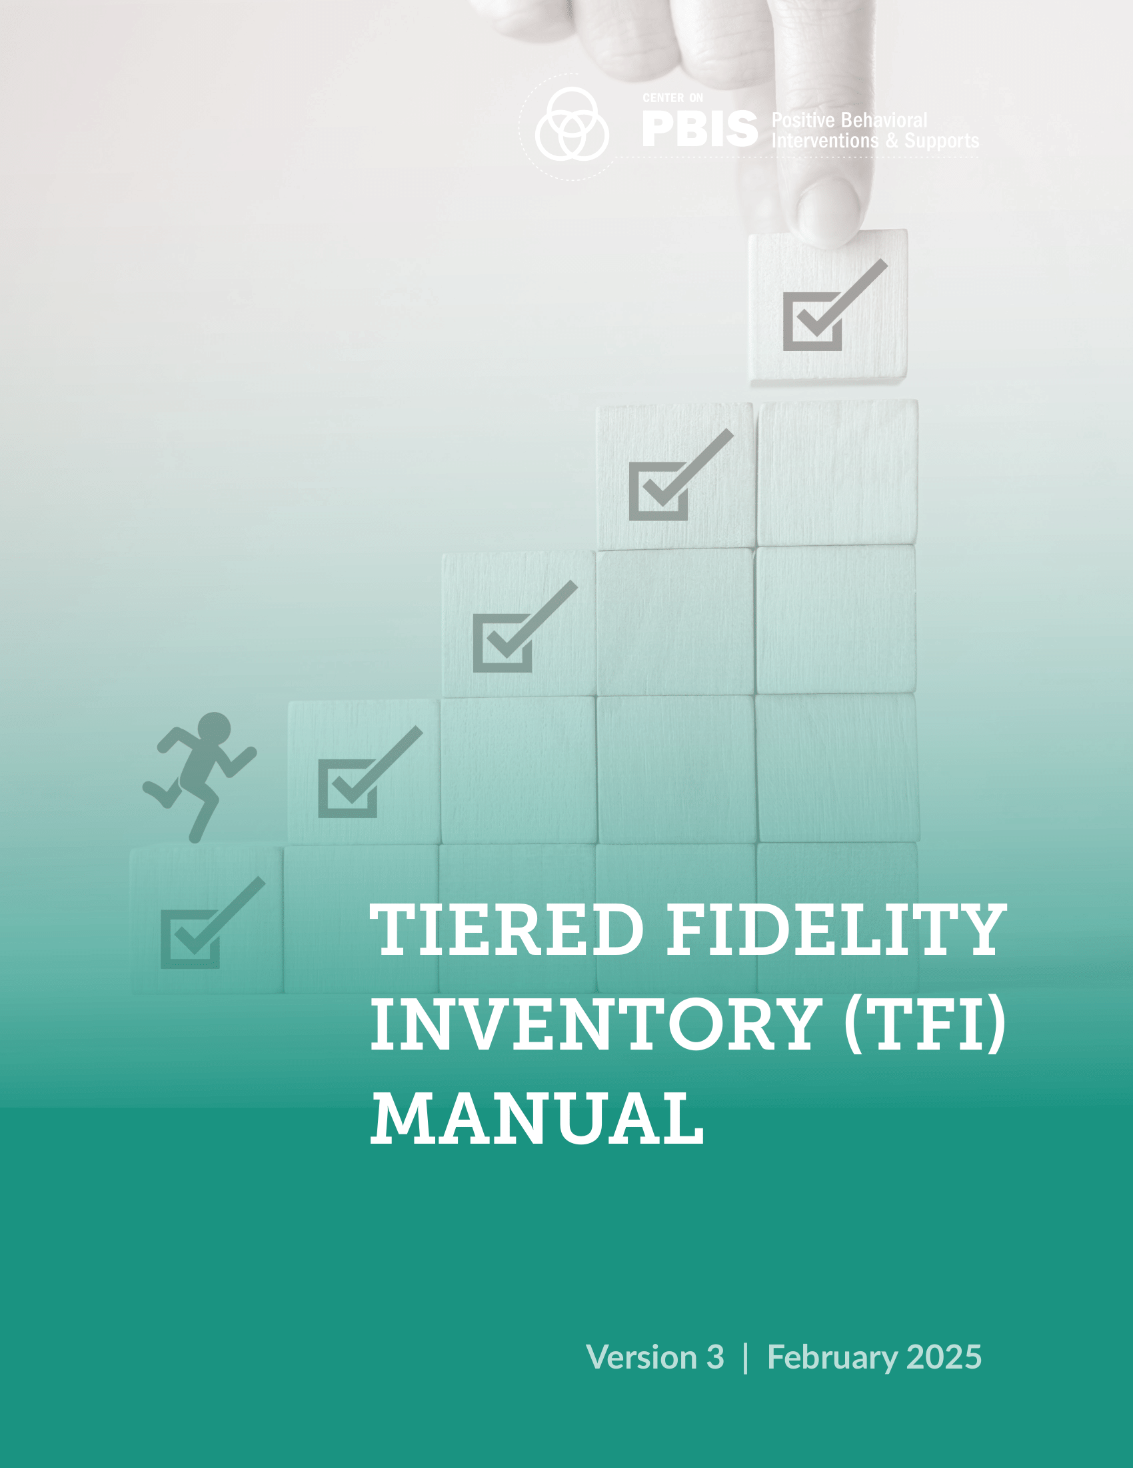
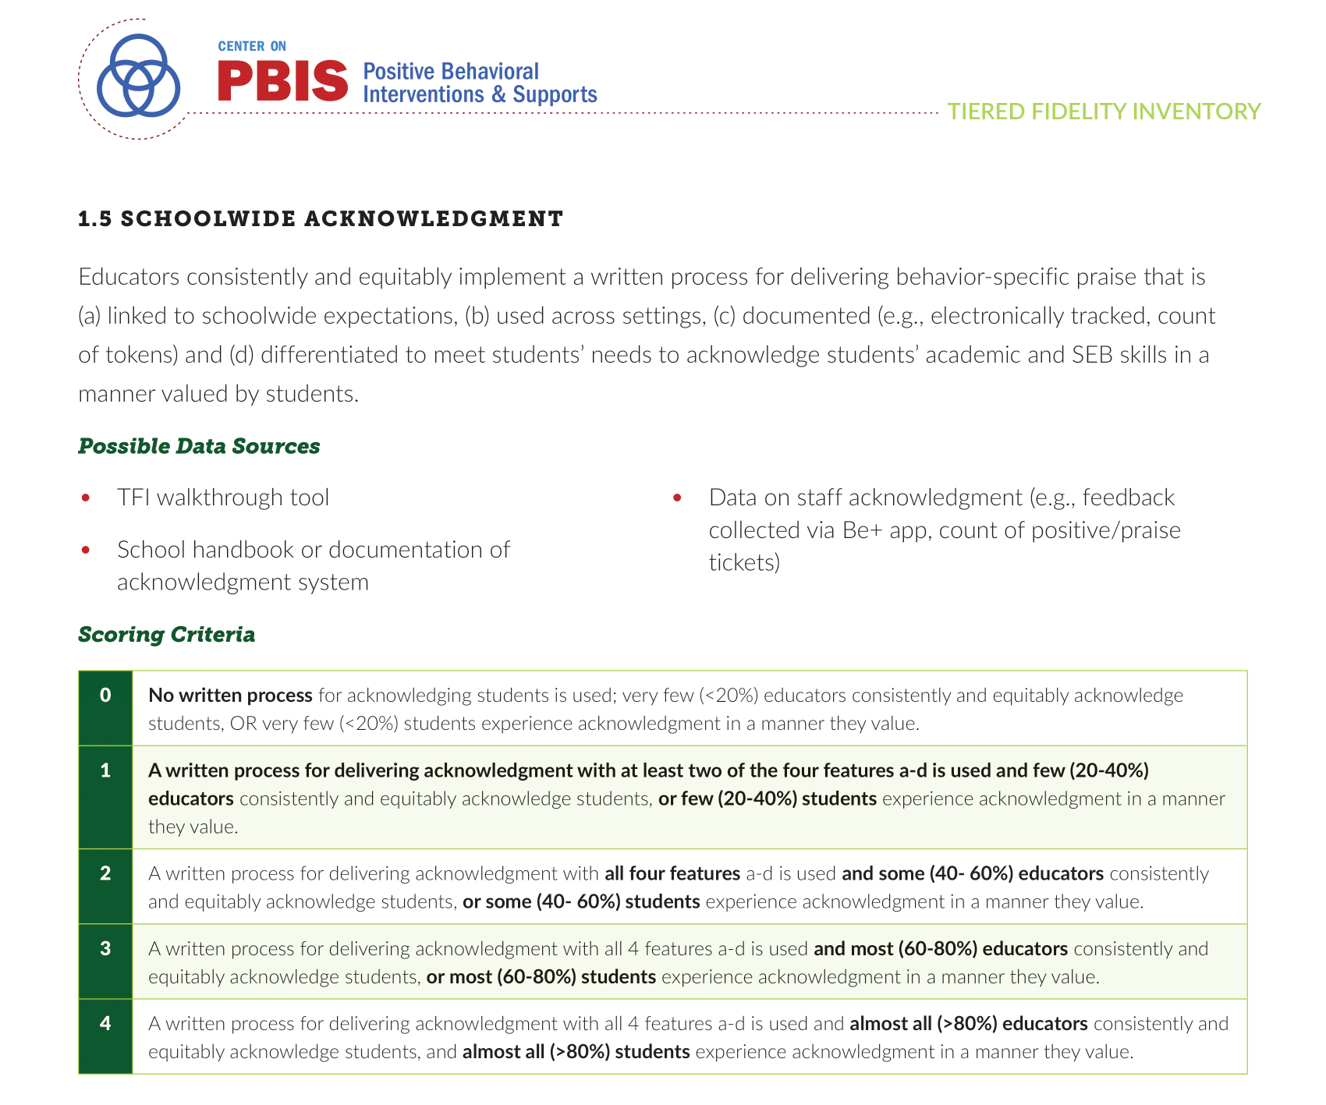
Tiered Fidelity Inventory
Notes:
Note- scoring now ranges from 0-4

Slide 22
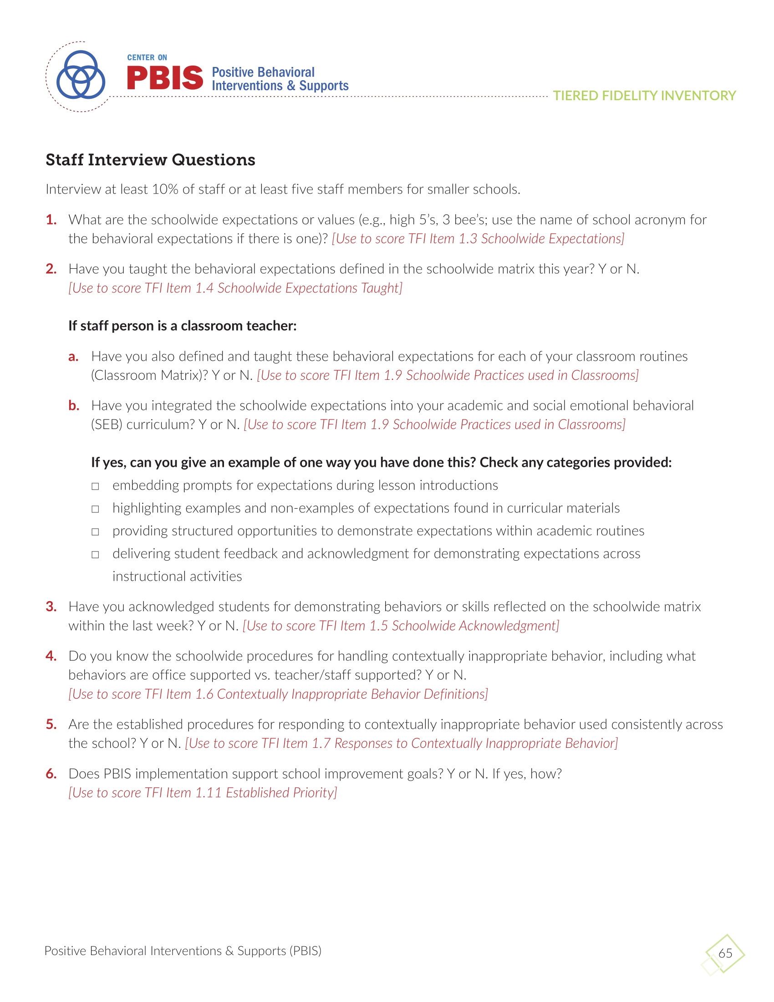
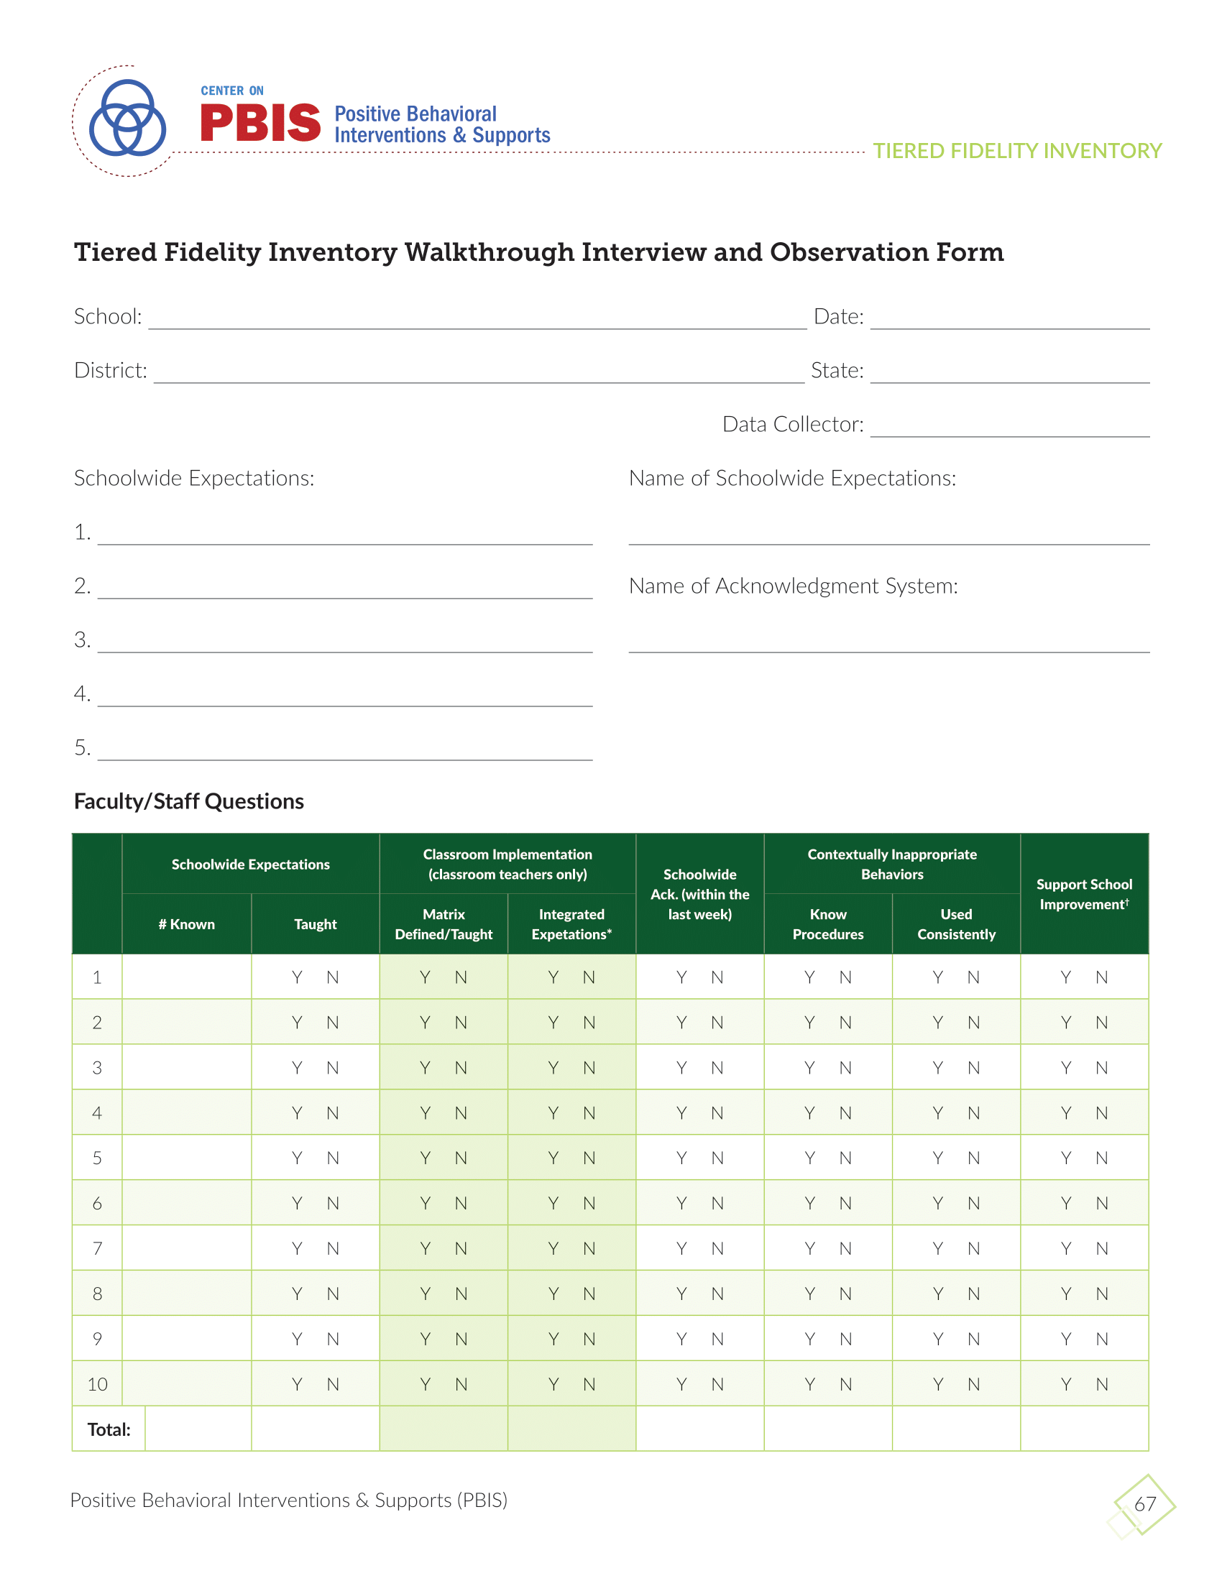
p.25
Notes:
Interview ~10% of staff
Note – new questions AND explicit connections to TFI items

Slide 23
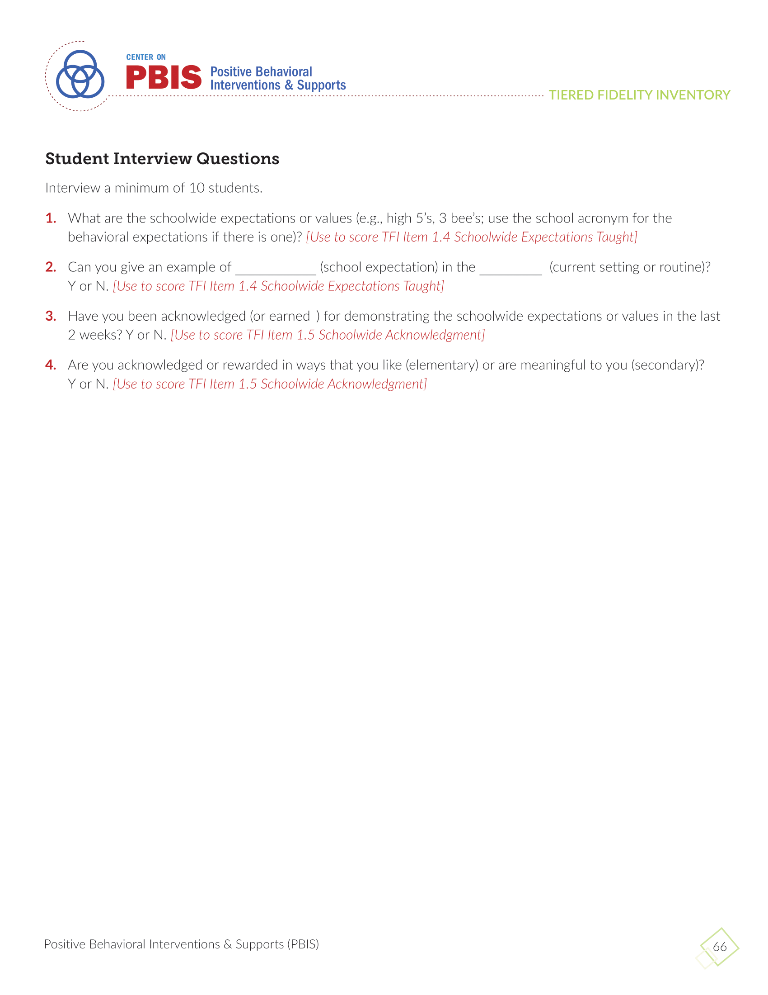
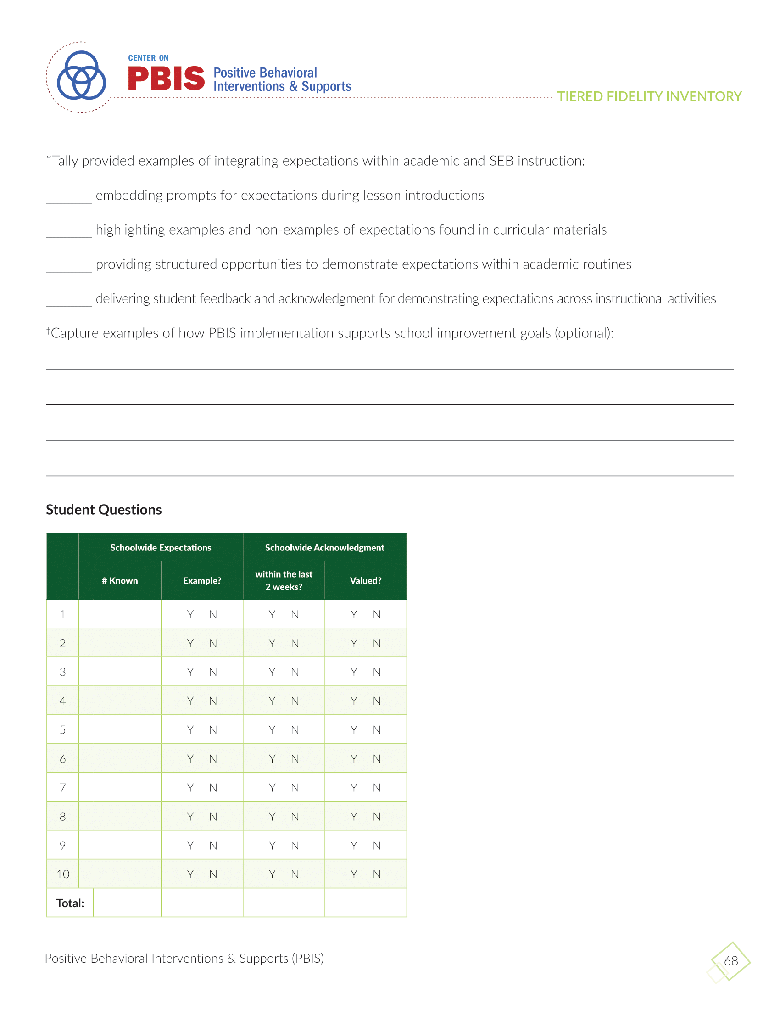
p.25
Notes:
Interview ~10% of students. Consider opportunities to divvy this up amongst multiple staff members and natural opportunities to interact with students (e.g., during arrival/dismissal)
Note – new questions AND explicit connections to TFI items

Slide 24
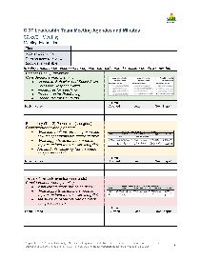
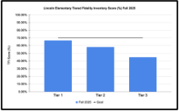
Tiered Fidelity Inventory: Tips for Success
Preparation (interviews, individually review items)
Score TFI at Ci3T Leadership Team Meeting
Share TFI Data
Item 1.3- Schoolwide expectations. Ready, set, show your score!
Notes:
Remember – you will need to conduct student and staff interviews prior to meeting as a team!
Identify time during an upcoming Ci3T Leadership Team Meeting to complete the Tiered Fidelity Inventory (TFI)
Ci3T Leadership Team members individually score the TFI before the meeting. During the meeting- read each item, everyone holds up fingers to reflect their score, quickly reach consensus OR make note of item to review later

Slide 25
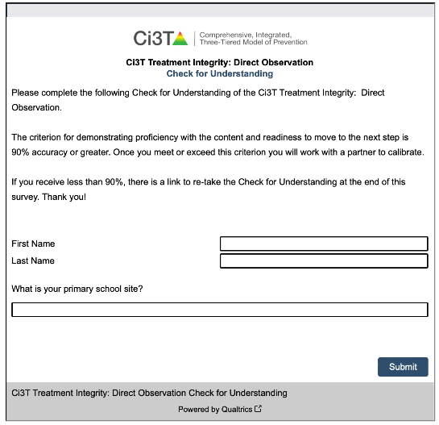
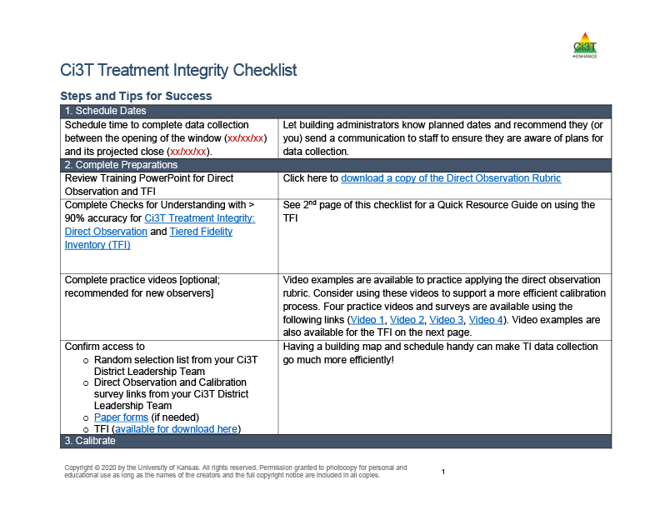
Ci3T Treatment Integrity: Direct Observation
Collaborate with your district to determine who will conduct Ci3T Treatment Integrity: Direct Observation

Slide 26



Sneak Peek: Implementation Session 3

Slide 27














Let’s discuss!
When will our faculty and staff complete the Ci3T Treatment Integrity: Teacher Self-Report & Primary Intervention Rating Scale Survey? When will our Ci3T Leadership Team complete the Tiered Fidelity Inventory (TFI) protocols? How / when will we collect student and staff interviews prior to meeting as a team? How will we share treatment integrity and social validity data with stakeholders (e.g., faculty & staff, families)?
Notes:
10 min timer

Slide 28

Systematic Screening in a Ci3T Model of Prevention
1.18 USING SCHOOL AND COMMUNITY DATA TO INFORM TIER 1
Tier 1 leadership team has regular access to and uses a variety of additional schoolwide (e.g., school climate surveys, attendance, nurse or counselor visit logs, universal screening) and community data sources (e.g., community resource profiles, basic needs [e.g., food and housing], health care access, community events), to develop and regularly re-evaluate a profile of overall strengths and needs that informs the development and delivery of equitable Tier 1 foundational and classroom practices (items 1.4-1.10).

Slide 29
Session Outcomes
Finalize plans to collect and use social validity and treatment integrity data.
Interpret fall screening data at the school- and classroom-level to inform professional learning and use of effective practices to support students (e.g., low-intensity strategies, Tier 2 and 3 interventions).
3. Reflect on use of strategies for communicating to and supporting all stakeholders and make adjustments as necessary to support the creation of collaborative, positive, productive, and safe learning environments

Slide 30
Essential Components of Primary (Tier 1) Prevention Efforts

Slide 31

Systematic Screening … Logistics
Fall
Winter
Spring
Selecting
Installing
Analyzing

Slide 32


Behavior Screening

Slide 33




Systematic Behavior Screening

Slide 34


Slide 36

Student Risk Screening Scale – Internalizing and Externalizing (SRSS-IE; Drummond, 1994; Lane & Menzies, 2009)
Elementary

Slide 37

Student Risk Screening Scale – Internalizing and Externalizing (SRSS-IE; Drummond, 1994; Lane & Menzies, 2009)
Secondary

Slide 38
SRSS-IE: Cut Scores
Elementary School |  | Middle and High School
SRSS-E7 | SRSS-I5 | SRSS-E7 | SRSS-I6
Items 1-7 | Items 8-12 | Items 1-7 | Items 4, 8-12
0-3 = low risk 4-8 = moderate risk 9-21 = high risk | 0-1 = low risk 2-3 = moderate risk 4-15 = high risk | 0-3 = low risk 4-8 = moderate risk 9-21 = high risk | 0-3 = low risk 4-5 = moderate risk 6-18 = high risk
Elementary School Level:
Lane, K. L., Oakes, W. P., Swogger, E. D., Schatschneider, C., Menzies, H., M., & Sanchez, J. (2015). Student risk screening scale for internalizing and externalizing behaviors: Preliminary cut scores to support data-informed decision making. Behavioral Disorders, 40, 159-170.
Middle and High School Levels:
Lane, K. L., Oakes, W. P., Cantwell, E. D., Schatschneider, C., Menzies, H., Crittenden, M., & Messenger, M. (2016). Student Risk Screening Scale for Internalizing and Externalizing Behaviors: Preliminary cut scores to support data-informed decision making in middle and high schools. Behavioral Disorders, 42(1), 271-284

Slide 39


Slide 40


Slide 41
Reviewing Screening Data
Ci3T Leadership Teams review screening data at the following levels:
Screening Practice
School-wide (e.g., Tier 1 efforts)
Grade or department (e.g., Tier 1 efforts, low-intensity strategies)
Class level (e.g., low-intensity strategies)
Individual student level (e.g., Tier 2 and Tier 3)

Slide 42

Academic Screening

Slide 43



Academic Screening
Notes:
Might consider beginning by looking at data broadly
compared against district or state benchmarks
Subgroup analyses

Slide 44



Academic Screening
Notes:
Then, might zoom in at the grade-level looking at distribution across risk category, mastery, or growth

Slide 45

Reviewing Multiple Sources of Data in an Integrated Way
attendance
behavior
screening
academic screening

Slide 46

Sharing Systematic Screening Data
Once academic and behavior screening data are collected, data are shared at the:
Screening Practice
School-wide (e.g., Tier 1 efforts)
Grade or department (e.g., Tier 1 efforts, low-intensity strategies)
Class level (e.g., low-intensity strategies)
Individual student level (e.g., Tier 2 and Tier 3)

Slide 47























Let’s discuss!
Use the Working with Your Screening Data Handout to review fall screening data Where are there strengths or bright spots? What are the greatest areas of need? School-level (e.g., Tier 1)? Grade or department level (e.g., Tier 1, low intensity strategies)? Classroom level (e.g., low intensity strategies)? Student-level (e.g., Tier 2 & Tier 3)
Notes:
20 min timer

Slide 48
Using Fall Screening Data to Inform Instruction
Primary (Tier 1) Prevention Efforts
Teacher-Delivered, Low-Intensity Strategies
Secondary (Tier 2) and Tertiary (Tier 3) Interventions

Slide 49

Using Systematic Screening Data
Academic and behavior screening data are reviewed alongside other data collected as part of typical school practices (e.g., attendance, office discipline referrals, grades) to:

Slide 50




Jigsaw
Using Systematic Screening Data to…
Inform Tier 1 Instruction | Teacher-Delivered, Low-Intensity Strategies | Connect Students with Validated Tier 2 and Tier 3 Supports

Slide 51

Jigsaw Room 1:
Using Fall Screening Data to Inform Primary (Tier 1) Prevention Efforts

Slide 52
Data to Indicate a Focus on Tier 1

Slide 53

Ci3T Primary (Tier 1) Plan

Slide 54




Ci3T Primary (Tier 1) Plan
Area I: Academics Responsibilities Faculty and Staff: Teach core programs according to district and state standards with integrity Use teacher-delivered, low-intensity strategies to support students’ active engagement | Area II: Behavior Responsibilities Faculty and Staff: Implement Positive Behavioral Interventions and Supports (PBIS) with integrity. Teach all setting Expectations within the first week of school and reteach Expectations (monthly). Display and model school-wide expectations in classrooms and other key settings. Implement the reactive plan with integrity. | Area III: Social Responsibilities Faculty and Staff: Teach schoolwide social skills/ character education curricula with integrity: Teach daily Second Step ® lessons (link to grade level instructional schedules) Seek ways to engage parents as partners in the school program

Slide 55



A Focus on: Integrated Lesson Planning

Slide 56


Integrated Lesson Plan
Citation. Oakes, W. P., Lane, K. L., Lane, K. S., & Buckman, M. M. (2019). Ci3T integrated lessons plan template. www.ci3t.org.​

Slide 57

Integrating Academic, Behavior and Social Domains Video
Notes:
Watch video 01:24
https://youtu.be/vNypqs6YVjA

Slide 58



Let’s Chat!
Let’s Chat! 1
What is one way you (or a teacher in your building) could integrate social skills or a behavioral objective into an upcoming lesson?
What low-intensity teacher-delivered strategies might you (or a teacher in your building) integrate into an upcoming lesson?

Slide 59





Ci3T: An Integrated Approach
Citation. Oakes, W. P., Lane, K. L., Lane, K. S., & Buckman, M. M. (2019). Ci3T integrated lessons plan template. www.ci3t.org.​
Completed examples available in: Ci3T Project ENHANCE Research Team. (2022, July). Embedding and integrating Ci3T domains into daily instruction. Author. https://doi.org/10.17161/ci3t.42880

Slide 60

Join us at future EMPOWER+ to learn more! 1
Join us at future EMPOWER+ to learn more!
EMPOWER+ Session | Date
Starting Strong: Effective Tier 1 Practices for Educators | September 24, 2025 (Wednesday)
From Data to Action: Using Systematic Screening to Inform Instruction | October 8, 2025 (Wednesday)
Ci3T In Action: Integrated Lesson Planning for Enhanced Instruction | November 18, 2025 (Tuesday)
Mastering Behavior Specific Praise and Precorrection | January 21, 2026 (Wednesday)
A 6-Step Instructional Approach for Responding to Challenging Behaviors: A Tier 1 Practice | February 10, 2026 (Tuesday)
A Tier 2 Support for Students Experiencing Anxious Feelings: Recognize. Relax. Record. | March 25, 2026 (Wednesday)
A Tier 3 Support for Students with Intensive Intervention Needs: Functional Assessment-Based Intervention (FABI) | April 28, 2026 (Tuesday)

Slide 61


A Focus on: Responding to Challenging Behavior
1.7 RESPONSES TO CONTEXTUALLY INAPPROPRIATE BEHAVIOR
Educators consistently and equitably implement a continuum of functionally-relevant, instructional, and restorative responses to contextually inappropriate behavior (e.g., response flowchart) that (a) reminds or (re) teaches expectations, as appropriate, to promote student SEB growth and wellness; (b) prioritizes student access to classroom instruction; and (c) emphasizes de-escalation and safety planning (e.g., a standard protocol for temporarily supporting students in crisis until more intensive supports can be implemented), when necessary, to reduce the need for crisis responses.

Slide 62

Reactive Plan: Flow Chart for Responding to Challenging Behavior

Slide 63


6-Step Instructional Approach for Responding to Challenging Behavior

Slide 64


Slide 65
Let’s Chat!
What components of the six-step instructional approach do you see implemented most effectively or consistently throughout your building?
What components of the six-step instructional approach could be strengthened or are not yet implemented with consistency throughout the building?

Slide 66





Module Connection!
6-Step Instructional Approach for Responding to Challenging Behavior

Slide 67

Join us at future EMPOWER+ to learn more! 2
Join us at future EMPOWER+ to learn more!
EMPOWER+ Session | Date
Starting Strong: Effective Tier 1 Practices for Educators | September 24, 2025 (Wednesday)
From Data to Action: Using Systematic Screening to Inform Instruction | October 8, 2025 (Wednesday)
Ci3T In Action: Integrated Lesson Planning for Enhanced Instruction | November 18, 2025 (Tuesday)
Mastering Behavior Specific Praise and Precorrection | January 21, 2026 (Wednesday)
A 6-Step Instructional Approach for Responding to Challenging Behaviors: A Tier 1 Practice | February 10, 2026 (Tuesday)
A Tier 2 Support for Students Experiencing Anxious Feelings: Recognize. Relax. Record. | March 25, 2026 (Wednesday)
A Tier 3 Support for Students with Intensive Intervention Needs: Functional Assessment-Based Intervention (FABI) | April 28, 2026 (Tuesday)

Slide 68


Reflection
How could integrated lesson planning help respond to your fall screening data?
How could the six-step instructional support help respond to your fall screening data?
What professional learning is necessary to support a focus on integrated lesson planning or the six-step instructional approach?
Notes:
15 min timer

Slide 69
Jigsaw Room 2:
Using Fall Screening Data to Inform Teacher-Delivered, Low-Intensity Strategies
1.10 CLASSROOM PRACTICES
Educators consistently and equitably implement positive and proactive classroom practices—including building relationships with students; developing a safe environment; prompting predictable routines and expected behavior; actively providing OTRs, active supervision, and specific feedback (i.e., specific praise and supportive corrections); and ensuring a high ratio (≥ 5:1) of positive to corrective feedback.

Slide 70

Data to Indicate a Focus on Low-Intensity Teacher-Delivered Strategies

Slide 71


Low-Intensity Teacher-Delivered Strategies

Slide 72



Slide 73


Slide 74


Slide 75


Slide 76


Slide 77


Slide 78


Slide 79


Notes:
Video = 2:45

Slide 80
Let’s Chat!
How do you (or how have you seen teachers) integrate low-intensity teacher-delivered strategies into lessons or daily routines?
OR
What opportunities exist to integrate low-intensity teacher-delivered strategies into lessons or daily routines?

Slide 81







Module Connection!
Instructional Feedback

Slide 82




Slide 83



Resources to Support Implementation

Slide 84



Family Resources

Slide 85


Resource Spotlight!
Notes:
What Works Clearing House Practice Guide – Teacher-Delivered Behavioral Interventions in Grades K-5- https://ies.ed.gov/ncee/wwc/PracticeGuide/31
Notice similar strategies and connections. In this presentation, we will situate these low-intensity strategies withing Ci3T

Slide 86


Join us at future EMPOWER+ to learn more!
EMPOWER+ Session | Date
Starting Strong: Effective Tier 1 Practices for Educators | September 24, 2025 (Wednesday)
From Data to Action: Using Systematic Screening to Inform Instruction | October 8, 2025 (Wednesday)
Ci3T In Action: Integrated Lesson Planning for Enhanced Instruction | November 18, 2025 (Tuesday)
Mastering Behavior Specific Praise and Precorrection | January 21, 2026 (Wednesday)
A 6-Step Instructional Approach for Responding to Challenging Behaviors: A Tier 1 Practice | February 10, 2026 (Tuesday)
A Tier 2 Support for Students Experiencing Anxious Feelings: Recognize. Relax. Record. | March 25, 2026 (Wednesday)
A Tier 3 Support for Students with Intensive Intervention Needs: Functional Assessment-Based Intervention (FABI) | April 28, 2026 (Tuesday)

Slide 87
Reflection
How could teacher-delivered low-intensity strategies help respond to your fall screening data?
What professional learning is necessary to support a focus on low-intensity strategies?
Notes:
15 min timer

Slide 88


Jigsaw Room 3:
Using Fall Screening Data to Inform Secondary (Tier 2) and Tertiary (Tier 3) Interventions
2.3 SCREENING
Tier 2 leadership team uses decision rules and multiple sources of data (e.g., discipline referrals, academic progress, screening tools, attendance, nominations), available from multiple informants (e.g., teacher, family, student), at multiple points in time (e.g., screening at identified points, on-going data review, on-going access to nomination process) to identify students who require Tier 2 internalizing or externalizing supports and to inform the modification or intensification of Tier 1 supports as needed.

Slide 89

Data to Indicate a Focus on Connecting Students to Tier 2 and Tier 3 Supports

Slide 90




Clarifying Tier 2 and Tier 3 Supports

Slide 91


Getting Started with Data-Informed Decision Making

Slide 92

Tier 2 and Tier 3 Intervention Grids
2.6 DECISION RULES FOR ASSIGNING AND EXITING STUDENTS FOR INTERVENTION
A written process and set of decision rules is used for (a) matching students to Tier 2 interventions that are aligned to student need, cultural fit, and family and student preference and (b) exiting students from intervention after reaching pre-determined levels of performance.
Notes:
Support- name of strategy, practice, or program. Notice this is not the name of a person or role

Slide 93



Secondary (Tier 2) Intervention Grid

Slide 94


Tier 2: Recognize.Relax.Record

Slide 95

Join us at future EMPOWER+ to learn more! 3
Join us at future EMPOWER+ to learn more!
EMPOWER+ Session | Date
Starting Strong: Effective Tier 1 Practices for Educators | September 24, 2025 (Wednesday)
From Data to Action: Using Systematic Screening to Inform Instruction | October 8, 2025 (Wednesday)
Ci3T In Action: Integrated Lesson Planning for Enhanced Instruction | November 18, 2025 (Tuesday)
Mastering Behavior Specific Praise and Precorrection | January 21, 2026 (Wednesday)
A 6-Step Instructional Approach for Responding to Challenging Behaviors: A Tier 1 Practice | February 10, 2026 (Tuesday)
A Tier 2 Support for Students Experiencing Anxious Feelings: Recognize. Relax. Record. | March 25, 2026 (Wednesday)
A Tier 3 Support for Students with Intensive Intervention Needs: Functional Assessment-Based Intervention (FABI) | April 28, 2026 (Tuesday)

Slide 96


Tertiary (Tier 3) Intervention Grid

Slide 97

Tier 3: Functional Assessment-Based Intervention

Slide 98

Join us at future EMPOWER+ to learn more! 4
Join us at future EMPOWER+ to learn more!
EMPOWER+ Session | Date
Starting Strong: Effective Tier 1 Practices for Educators | September 24, 2025 (Wednesday)
From Data to Action: Using Systematic Screening to Inform Instruction | October 8, 2025 (Wednesday)
Ci3T In Action: Integrated Lesson Planning for Enhanced Instruction | November 18, 2025 (Tuesday)
Mastering Behavior Specific Praise and Precorrection | January 21, 2026 (Wednesday)
A 6-Step Instructional Approach for Responding to Challenging Behaviors: A Tier 1 Practice | February 10, 2026 (Tuesday)
A Tier 2 Support for Students Experiencing Anxious Feelings: Recognize. Relax. Record. | March 25, 2026 (Wednesday)
A Tier 3 Support for Students with Intensive Intervention Needs: Functional Assessment-Based Intervention (FABI) | April 28, 2026 (Tuesday)

Slide 99



Selecting an Intervention
Selecting an Intervention 1

Slide 100


Selecting an Intervention
Selecting an Intervention 2
Collaborate with families, colleagues, and the student to review available options
Consider what you know about the student (e.g., strengths, preferences, pre-requisite skills)
Consider possible function of the behavior
  Check-In Check Out is may be more effective for students who find accessing adult attention reinforcing
Consider your own strengths, support available (e.g., coach, professional learning), and feasibility of available options
Adjust as needed based on pre-intervention social validity

Slide 101

Let’s Practice Together!
Notes:
Facilitator has copy of Ci3T Data Dashboard- https://docs.google.com/spreadsheets/d/135hDmcTOIjAwb_8Ci-hNR38uF9vs7oUcVzjeSxVM2a8/edit?usp=sharing
Model:
Filter
Moderate internalizing
Below grade level reading
Attendance – now what do you notice
Ci3T Implementation Manual
What intervention(s) might be appropriate for this student? (e.g., self-monitoring w/ reading, breathing strategy)

Slide 102

Document Decisions and Plan for Next Steps

Slide 103

Document Decisions and Plan for Next Steps

Slide 104





Module Connection!
The Tier 2 Process: Using Data to Connect Students to Validated Supports

Slide 105




Module Connection!
The Tier 3 Process: Using Data to Connect Students to Validated Supports

Slide 106

Reflection
Based on your screening data, which Tier 2 and Tier 3 supports are most needed?
What structures currently exist to connect students with Tier 2 and Tier 3 supports?
What professional learning is necessary to support a focus on connecting students with Tier 2 and Tier 3 supports?

Slide 107
Facilitating Clear Communication and Collaborations with Stakeholders
Communicating and Collaborating with your:
District
Ci3T Leadership Team
Faculty and Staff
Students, Parents, and Community
Policy Makers
1.16 FAMILY AND COMMUNITY ENGAGEMENT
Tier 1 leadership teams purposefully and regularly engage families and community members that are representative of (a) the schools’ demographics and (b) any marginalized groups in co-designing and actively revising the content and the implementation of foundational Tier 1 practices (items 1.3-1.10) based on the regular review of schoolwide and community data.

Slide 108
Session Outcomes
Finalize plans to collect and use social validity and treatment integrity data.
Interpret fall screening data at the school- and classroom-level to inform professional learning and use of effective practices to support students (e.g., low-intensity strategies, Tier 2 and 3 interventions).
3. Reflect on use of strategies for communicating to and supporting all stakeholders and make adjustments as necessary to support the creation of collaborative, positive, productive, and safe learning environments

Slide 109



Slide 110
Foundational Ci3T Implementation & Professional Learning Activities

Slide 111
Foundational Ci3T Implementation & Professional Learning Activities

Slide 112
Foundational Ci3T Implementation & Professional Learning Activities

Slide 113


Communicating and Collaborating with Families

Slide 114


Communicating and Collaborating with Families
Notes:
https://www.pbis.org/resource/resources-to-support-systematic-screening-in-k-12-schools

Slide 115


Communicating and Collaborating with Families

Slide 116


Communicating and Collaborating with Faculty and Staff

Slide 117







Communicating and Collaborating with Faculty and Staff

Slide 118

Communicating with Stakeholders

Slide 119

















Let’s discuss!
Debrief Jigsaw Share key takeaways from the breakout room you attended: Inform Tier 1 Instruction Empower teachers with low-intensity strategies Connect students with Tier 2 and Tier 3 supports What are the next steps to respond to your fall screening data? Be ready to share at least one concrete action step your team is taking coming out of today’s session! | Communicating and Collaborating with Stakeholders What upcoming opportunities exist to communicate and collaborate with families? What strategies do you currently use to communicate and collaborate with faculty and staff? What new strategies to communicate and collaborate with faculty & staff are you interested in trying?
Notes:
15-min timer

Slide 120
Wrapping Up and Moving Forward

Slide 121
Let’s Chat!
What is 1 action item you or your team is taking following today’s session?

Slide 122

Project EMPOWER+
EMPOWER+ Session | Date
Starting Strong: Effective Tier 1 Practices for Educators | September 24, 2025 (Wednesday)
From Data to Action: Using Systematic Screening to Inform Instruction | October 8, 2025 (Wednesday)
Ci3T In Action: Integrated Lesson Planning for Enhanced Instruction | November 18, 2025 (Tuesday)
Mastering Behavior Specific Praise and Precorrection | January 21, 2026 (Wednesday)
A 6-Step Instructional Approach for Responding to Challenging Behaviors: A Tier 1 Practice | February 10, 2026 (Tuesday)
A Tier 2 Support for Students Experiencing Anxious Feelings: Recognize. Relax. Record. | March 25, 2026 (Wednesday)
A Tier 3 Support for Students with Intensive Intervention Needs: Functional Assessment-Based Intervention (FABI) | April 28, 2026 (Tuesday)

Slide 123

Ci3T Trainers and Coaches Calls
Ci3T Trainers and Coaches Calls Location: Remote via Zoom Attended by: Ci3T Leadership Teams, Ci3T Trainers and Coaches, Faculty and Staff, Families (adults only), Community Members
Session | Date | Times (Central)
Ci3T Trainers and Coaches Call 1 | Aug. 20, 2025 (Wed) | 4:00 – 5:00 p.m.
Ci3T Trainers and Coaches Call 2 | Sept. 03, 2025 (Wed) | 4:00 – 5:00 p.m.
Ci3T Trainers and Coaches Call 3 | Oct. 01, 2025 (Wed) | 4:00 – 5:00 p.m.
Ci3T Trainers and Coaches Call 4 | Nov. 05, 2025 (Wed) | 4:00 – 5:00 p.m.
Ci3T Trainers and Coaches Call 5 | Dec. 02, 2025 (Tues) | 4:00 – 5:00 p.m.
Ci3T Trainers and Coaches Call 6 | Jan. 22, 2026 (Thurs) | 4:00 – 5:00 p.m.
Ci3T Trainers and Coaches Call 7 | Feb. 17, 2026 (Tues) | 4:00 – 5:00 p.m.
Ci3T Trainers and Coaches Call 8 | Mar. 10, 2026 (Tues) | 4:00 – 5:00 p.m.
Ci3T Trainers and Coaches Call 9 | Apr. 15, 2026 (Wed) | 4:00 – 5:00 p.m.
Ci3T Trainers and Coaches Call 10 | May 13, 2026 (Wed) | 4:00 – 5:00 p.m.

Slide 124
Wrap Up and Preview
Today
Next time
Preparing to Collect and Use Social Validity & Treatment Integrity Data
Systematic Screening in a Ci3T Model of Prevention
Using Fall Screening Data to Inform:
  Primary (Tier 1) Prevention Efforts
  Teacher-Delivered, Low-Intensity Strategies
  Secondary (Tier 2) and Tertiary (Tier 3) Supports
Facilitating Clear Communication and Collaborations with Stakeholders
Wrapping Up and Moving Forward
Procedures for Monitoring
  Review your School’s Social Validity & Treatment Integrity Data
  Review your School’s Winter Screening Data
Data-informed Decision-making
  Professional Learning Targets and Resources
  Communication Plans

Slide 125

Homework
Schedule time for faculty and staff to complete:
  Primary Intervention Rating Scale (PIRS)
  Treatment Integrity: Teacher Self-Report (Ci3T TI: TSR)
At your next Ci3T Leadership Team meeting:
  Complete the Tiered Fidelity Inventory – Version 3
At your next faculty meeting:
  Share Fall systematic screening data, takeaways, and professional learning with faculty and staff (e.g., emphasis on use of teacher-delivered, low-intensity strategies, Tier 2 and Tier 3 strategies)

Slide 126


Action Planning
Schedule time for staff to complete TSR and PIRS
Elise
11/01/25
Complete student and staff interviews for TFI
Allison
11/08/25
Prepare screening data presentation for 11/13 faculty meeting
Mark
11/08/25
Notes:
Encourage you to leave a note in your Ci3T LT agenda to indicate where your team will pick up at your next meeting and to record any action items.

Slide 127


Coaching Protocol Reminder
Notes:
If you’re a coach, you might consider setting aside time to review coaching protocol for Session 1 especially the after coaching tips, action items, and reflection!

Slide 128






@Ci3Tmodel
@Ci3Tmodel
Tag us in your Ci3T highlights, we love to see Ci3T in action!
Follow us on X and Instagram for updates and new resources!
Thank you!
ci3t.org
#Ci3T
Notes:
Tag us in your Ci3T highlights- we’d love to see Ci3T in action! Follow us on Twitter or Instagram for updates and links to resources! @Ci3TModel
You will receive a brief session evaluation – we value your feedback and would greatly appreciate you taking a few minutes to share your thoughts on what you liked about the session and how we can improve

